Slide 1


Download & Setup Fabric Sample BYFN
Generate Crypto & launch network
View Artifacts
Download & Setup Hyperledger Explorer
Run the explorer

Slide 2
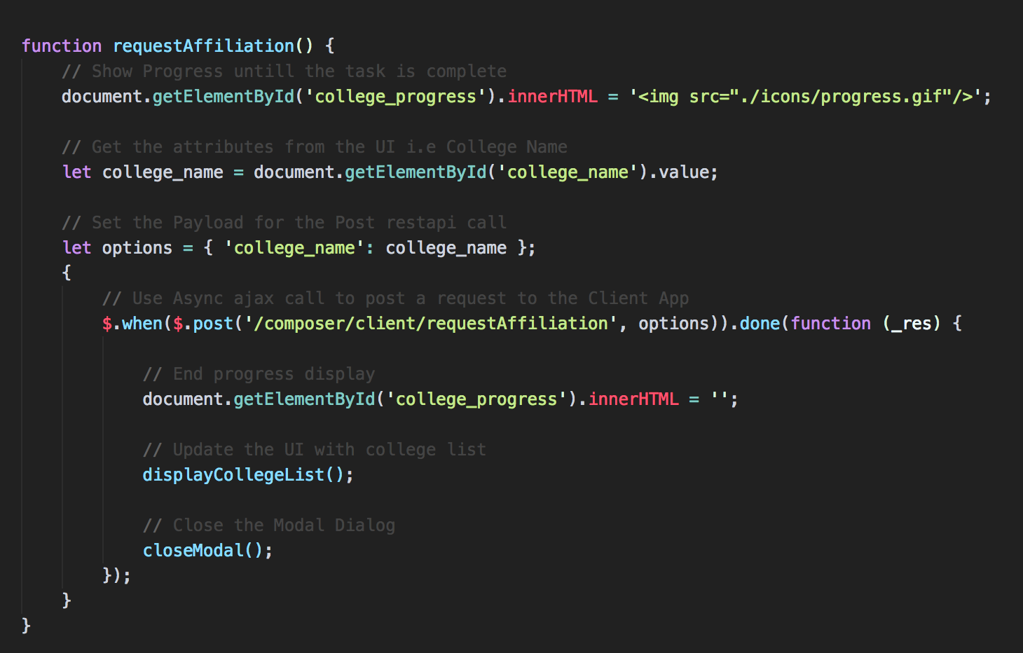
Will will setup router to call client app api in next Task

Slide 3
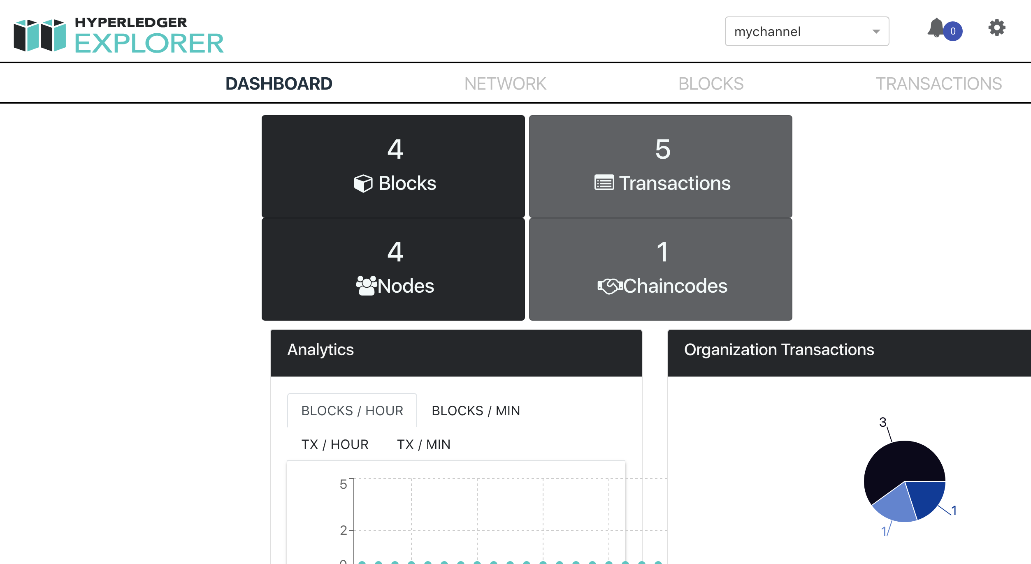
Will Display all comm channels

